Slide 1


THE BIOLOGY OF MIND

Slide 2

DO YOU HAVE MIND?
WHAT IS IT?
WHERE IS IT?

Slide 3
YOUR MIND IS WHAT YOUR BRAIN DOES,
WHICH REGULATES AND
PROCESSING INFORMATION

Slide 4
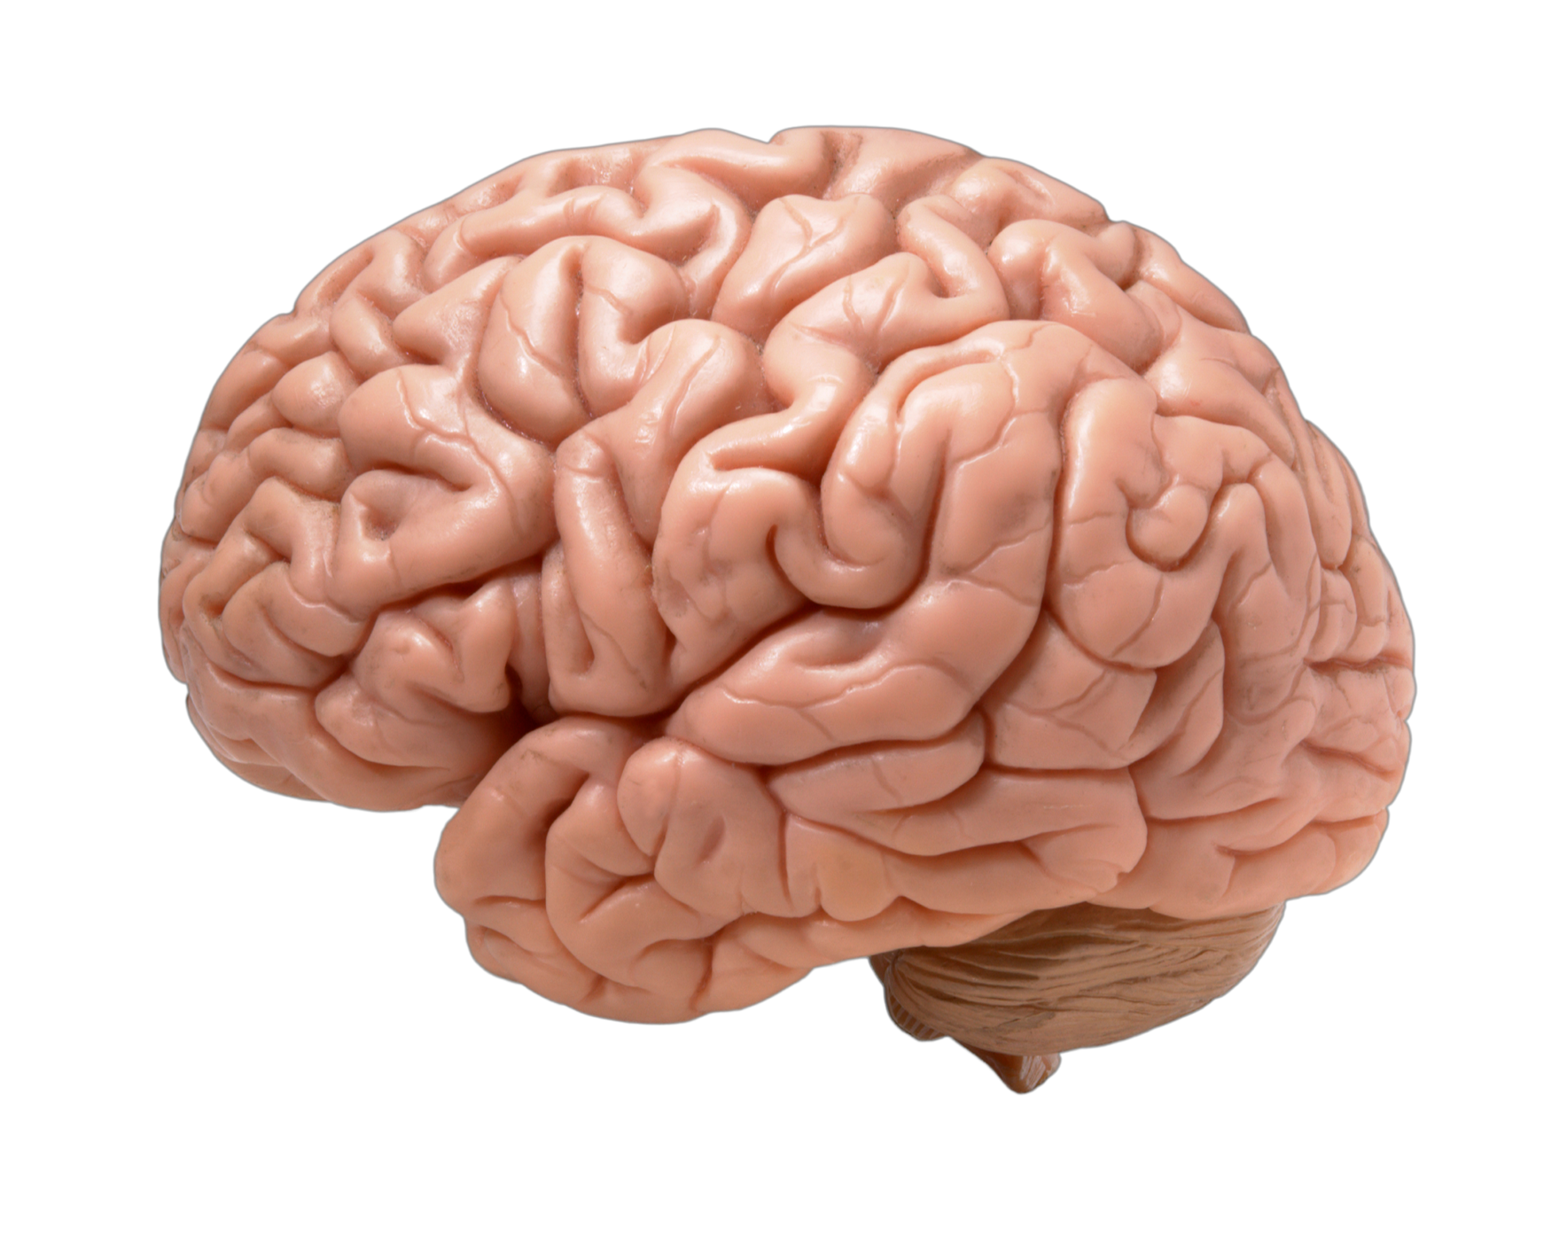
THE BRAIN

Slide 5
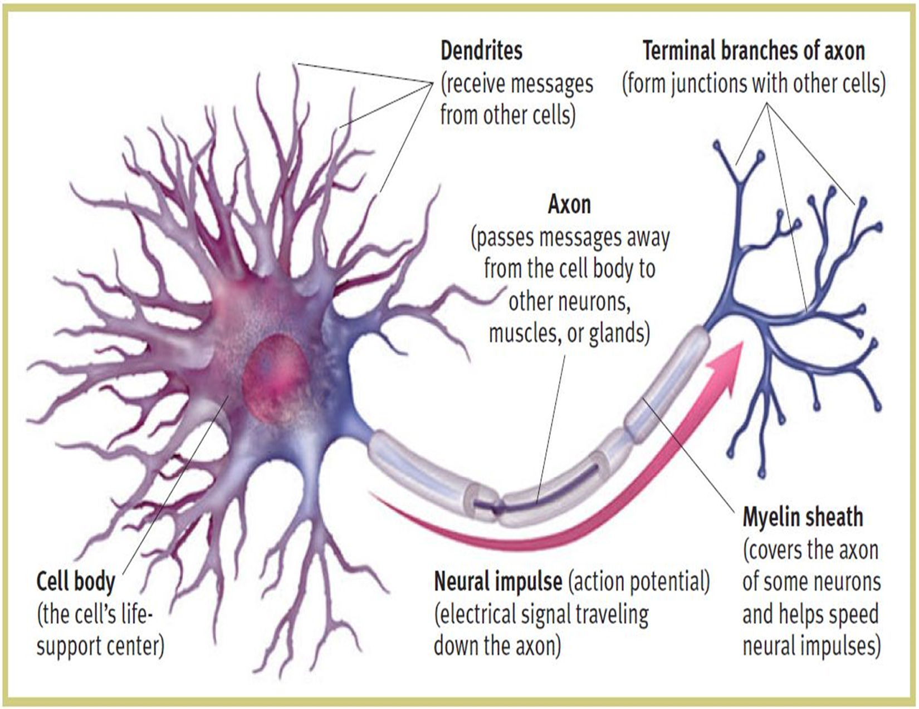
NEURON

Slide 6
https://www.youtube.com/watch?v=HUuUUJktL6E

Slide 7
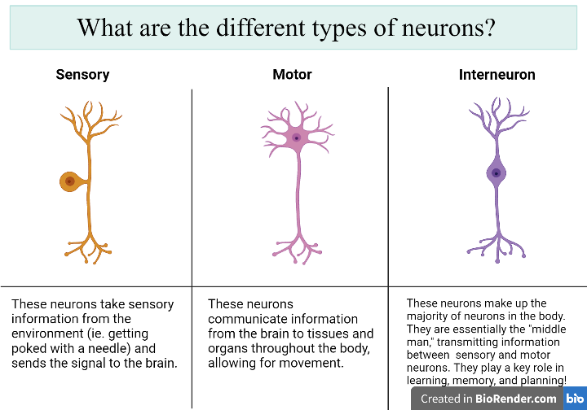

Slide 8
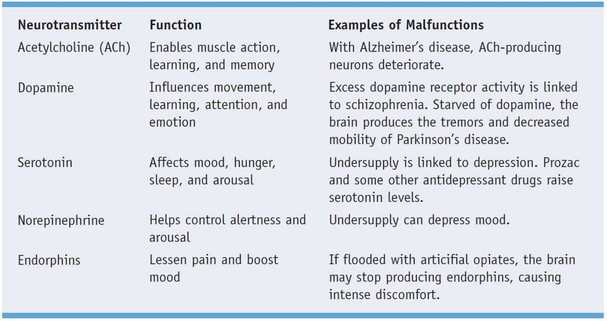

Slide 9
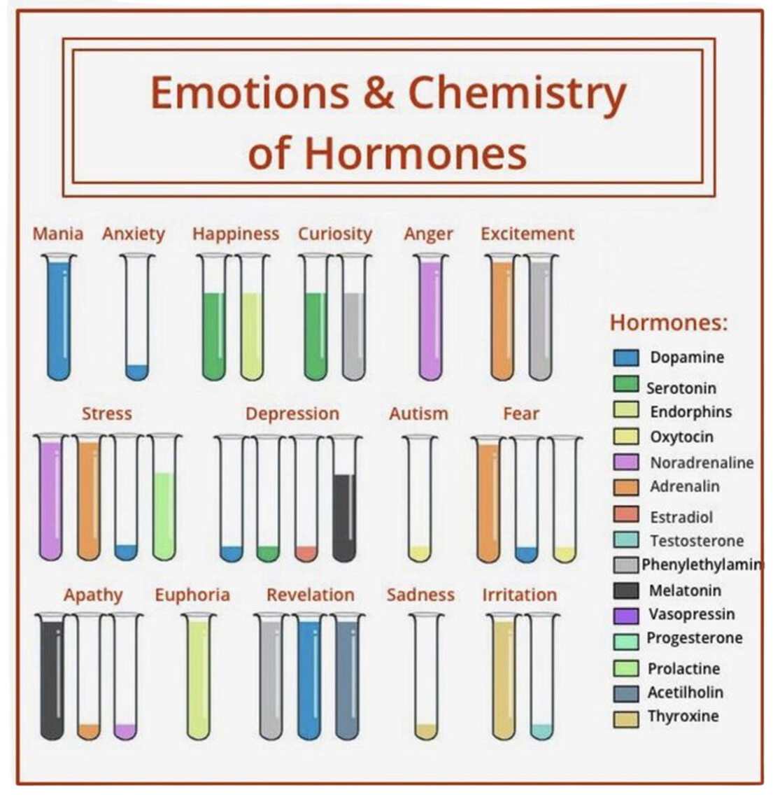

Slide 10
THE NERVOUS SYSTEM
The central command store of our body.
Thoughts, memory, learning, and feelings.
Movements, such as balance and coordination.
Senses, including how your brain interprets what you see, hear, taste, touch and feel.
Sleep, healing and aging.
Heartbeat and breathing patterns.
Response to stressful situations.
Digestion, as well as how hungry and thirsty you feel.
Body processes, such as puberty.

Slide 11
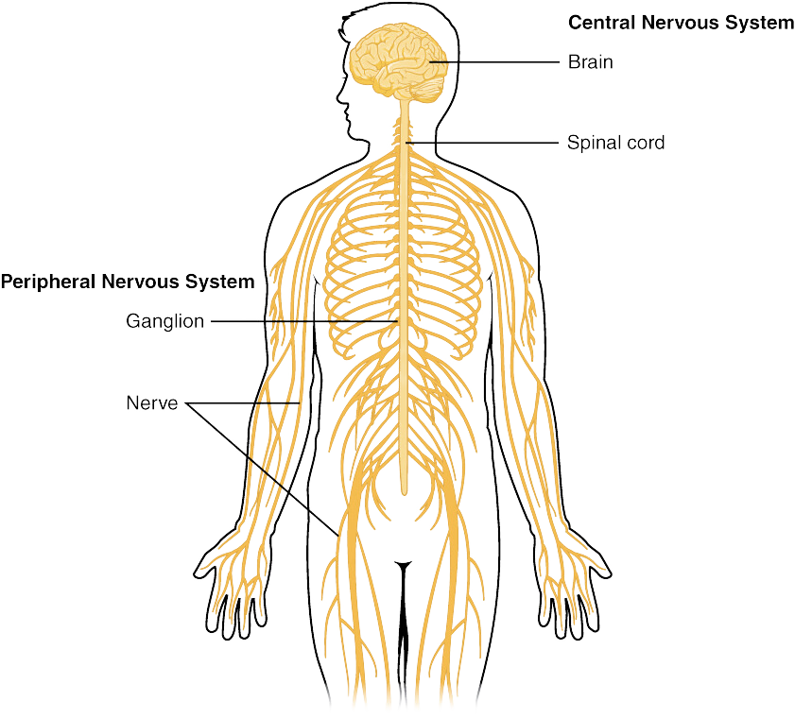

Slide 12
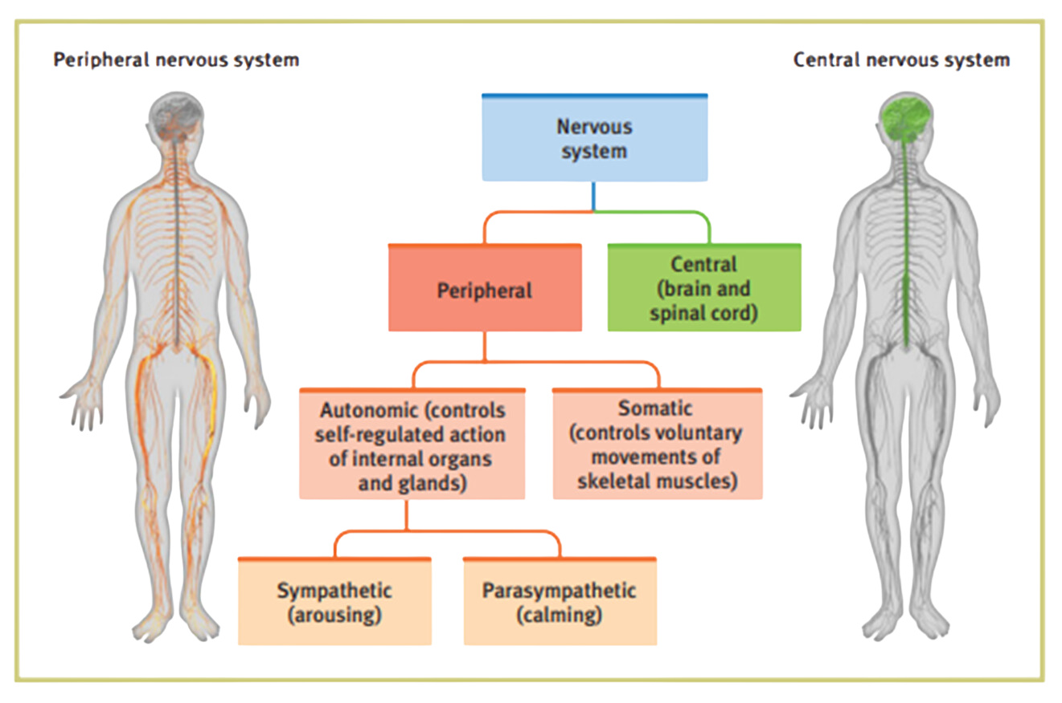

Slide 13
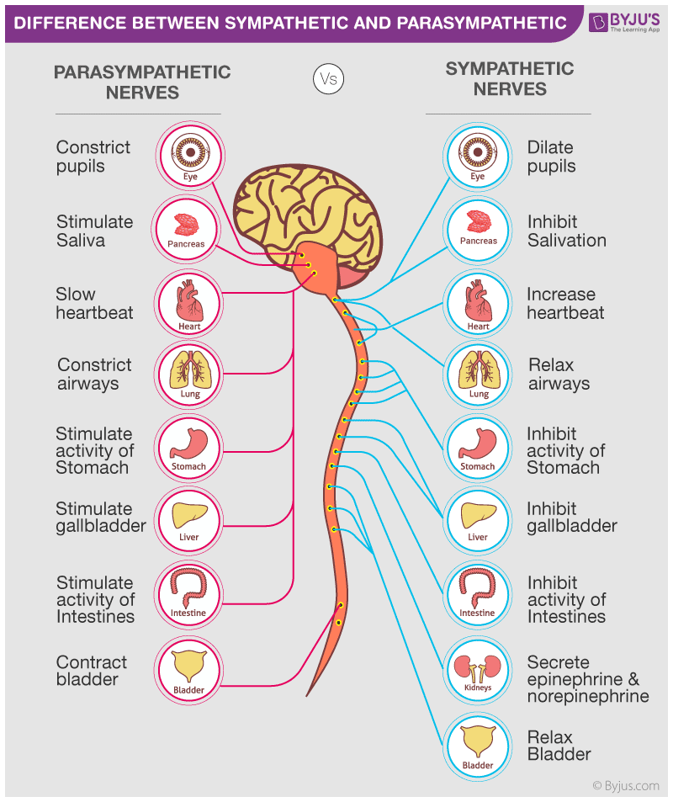

Slide 14
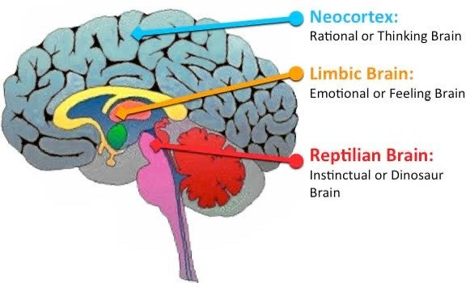

Slide 15
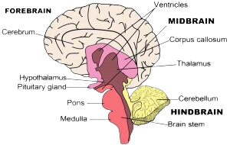
THE ORGANIZATION OF BRAIN
CEREBRAL CORTEX
LIMBIC SYSTEM
THE BRAINSTEM

Slide 16
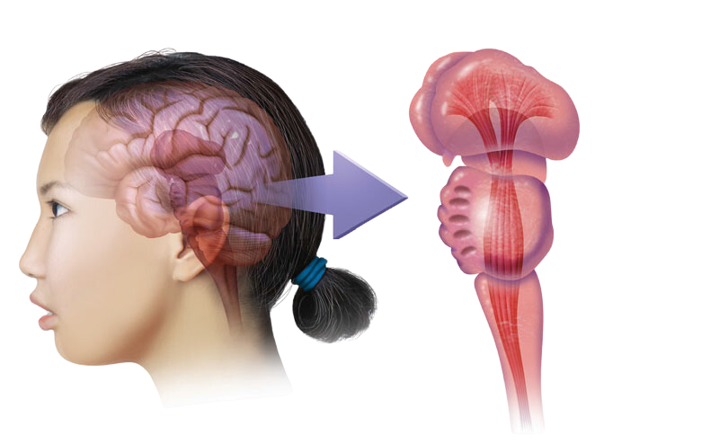
THE BRAIN STEM
THALAMUS
RETICULAR FORMATION
PONS
BRAIN STEM
MEDULA

Slide 17
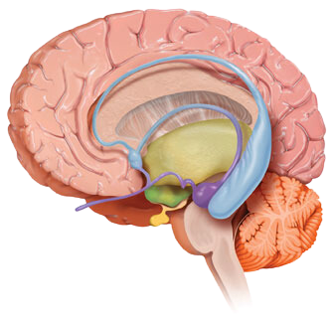
THE LIMBIC SYSTEM
THALAMUS
PITUITARY GLAND
AMYGDALA
HIPPOCAMPUS
THALAMUS
PITUITARY GLAND
AMYGDALA
HIPPOCAMPUS

Slide 18
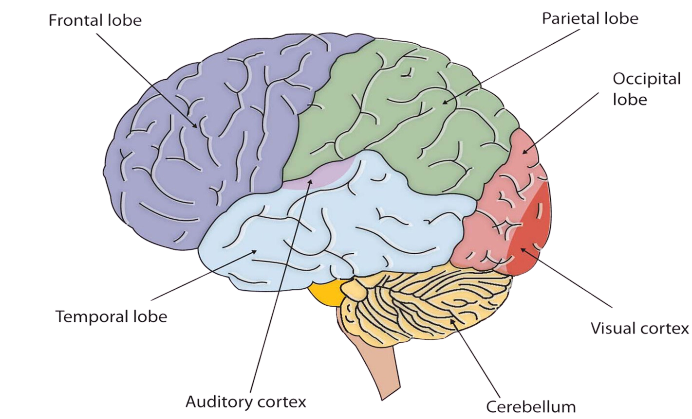
THE CORTEX

Slide 19
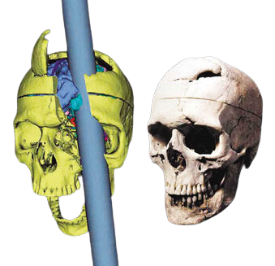
PHINEAS GAGE
One afternoon in 1848, Gage, then 25 years old, was packing gunpowder into a rock with a tamping iron. A spark ignited the gunpowder, shooting the rod up through his left cheek and out the top of his skull, leaving his frontal lobes massively damaged. To everyone’s amazement, he was immediately able to sit up and speak, and after the wound healed he returned to work. But the affable, soft -spoken Phineas Gage was now irritable, profane, and dishonest. Although his mental abilities and memories were intact, his personality was not. This person, said his friends, was “no longer Gage.” He eventually lost his job and ended up earning his living as a fairground exhibit.

Slide 20
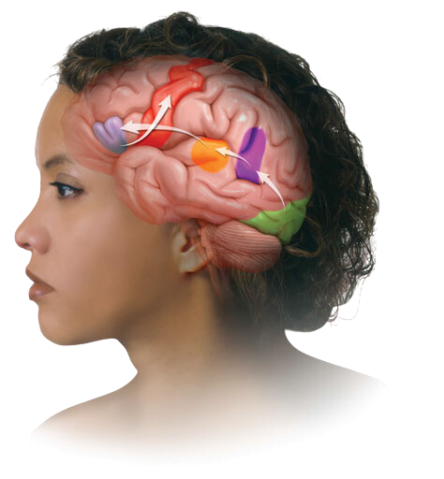
Aphasia, an impaired use of language, can result from damage to any one of several cortical areas.
In 1865, French physician Paul Broca reported that after damage to a specific area of the left frontal lobe (later called Broca’s area) a person would struggle to speak words while still being able to sing familiar songs and comprehend speech. Damage to Broca’s area disrupts speaking.
In 1874, German investigator Carl Wernicke discovered that after damage to a specific area of the left temporal lobe (Wernicke’s area) people could speak only meaningless words. Asked to describe a picture that showed two boys stealing cookies behind a woman’s back, one patient responded: “Mother is away her working her work to get her better, but when she’s looking the two boys looking the other part. She’s working another time” (Geschwind, 1979). Damage to Wernicke’s area also disrupts understanding.
A third brain area, the angular gyrus, is involved in reading aloud. It receives visual information from the visual area and records it into an auditory form, which Wernicke’s area uses to derive its meaning. Damage to the angular gyrus leaves a person able to speak and understand, but unable to read.
MOTOR CORTEX
(word is pronounced)
BROCA’S AREA
(controls speech
muscles via
the motor cortex)
ANGULAR GYRUS
(transforms visual
representations into
an auditory code)
WERNICKE’S AREA
(interprets auditory code)
VISUAL CORTEX
(receives written words
as visual stimulation)

Slide 21
How do you approach problem-solving?
I rely on intuition
I break the problem down into smaller steps and use logic.
How do you process information better?
Through images, patterns, and stories.
Through numbers, facts, and clear sequences.
When learning something new, do you prefer hands-on experience or reading detailed instructions?
I prefer hands-on experience and experimenting.
I prefer reading instructions or following a clear guide.
In your free time, what type of activities do you enjoy most?
Creative hobbies, such as painting, writing, or playing music.
Analytical activities like puzzles, math, or strategy games.

Slide 22
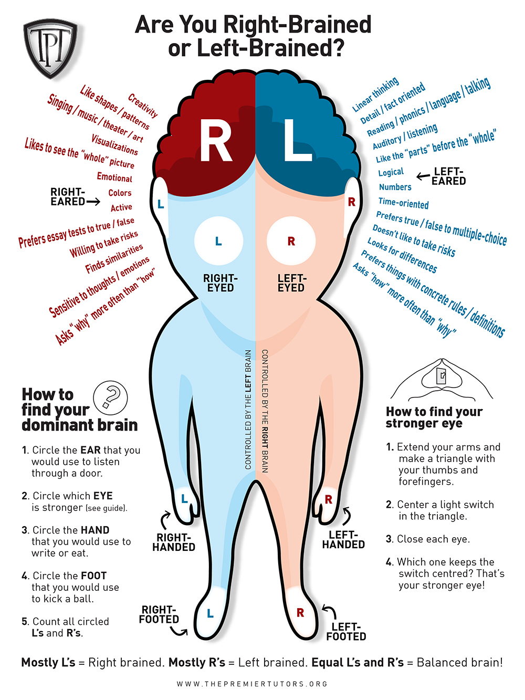

Slide 23
HOW TO ENHANCE BRAIN FITNESS?

Slide 24
SOUND SLEEP
Do your best to get 7.5 hours of sleep and if you need to take a nap, take one! If you are one of those people that think sleep is weak and you run just fine on your 6 hours, try getting 7.5 and see how efficient you are, how much better you feel, and notice how good your mood is throughout the day!

Slide 25
EAT WELL
It shouldn't come as a surprise that nutrition plays a significant part in your brain health. Entrepreneurs are often rushing from one meeting to another, leaving themselves with very little or no time to eat well.
You have to focus on getting the right kind of nutrition. Antioxidants and amino acids are particularly important, and vitamin E can also be beneficial.
Nuts, blueberries, whole grains, avocados, fish oil, broccoli, tomato, seeds and water are beneficial. What's good for your body also tends to be good for your brain.

Slide 26
WRITE THINGS DOWN
There are several ways to start doing this. One is write down tomorrow’s activities/responsibilities the night before. What this does is release any worry about what you have to do the next day and you will sleep like a baby! It also allows you to wake up the next day and just follow a schedule…no-brainer! Even though it is better to write things down by hand, have an app on your phone where you can always jot things down when they come to mind. We have so many great ideas that come and go, if you don’t capture them, you may lose it forever!

Slide 27
SLOW DOWN
This one is pretty simple, but for some reason one of the hardest. We are so “trained” to go fast, and get things done, but it is that mentality that creates the mess! So, write down the things you're going to do in the next hour/day and mindfully do them one at a time, spend some good time with friends and families, do the things you like, make new friends and connections, be empathetic to others. You will find that you feel better as you get each one done and more relaxed.

Slide 28

BREATHe

